Slide 1

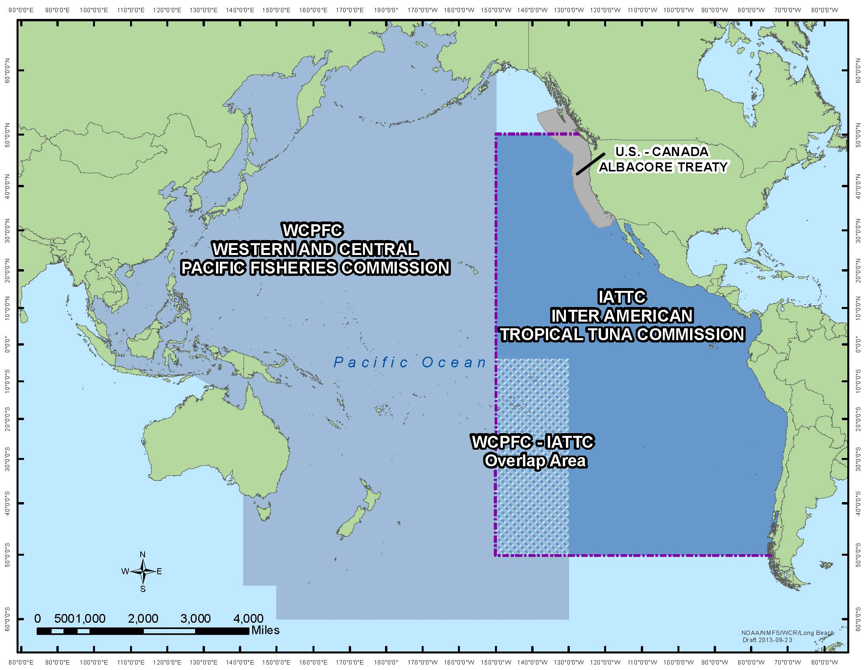
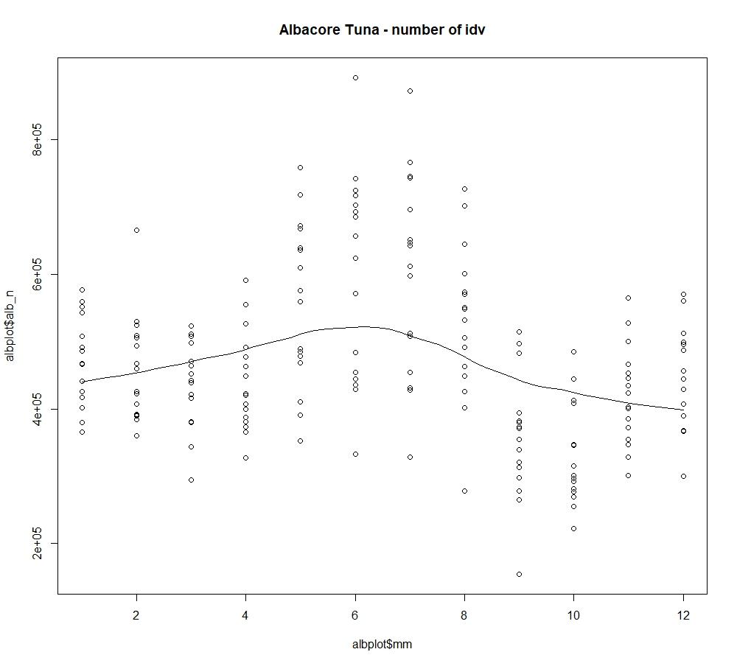
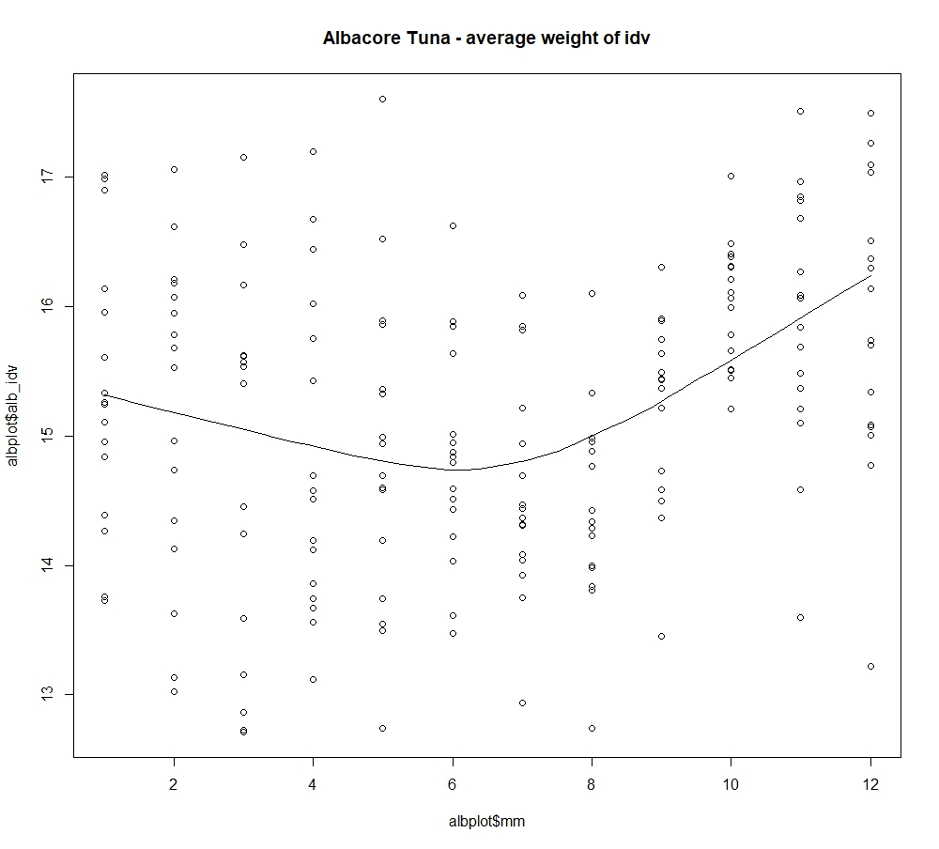

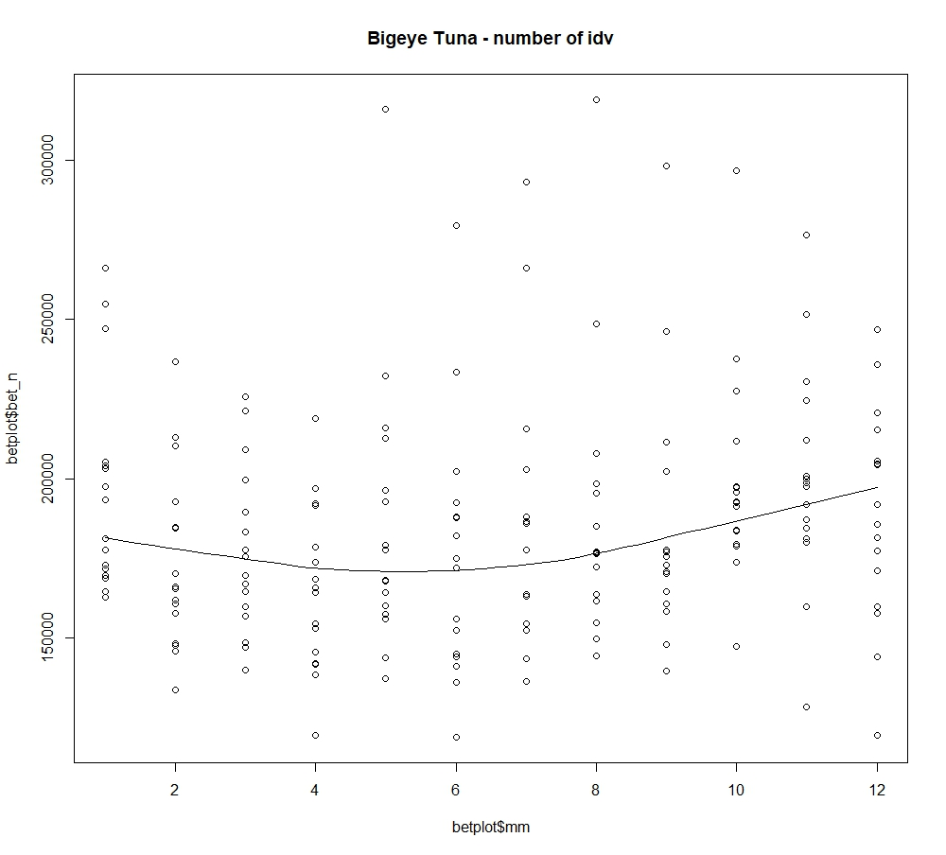
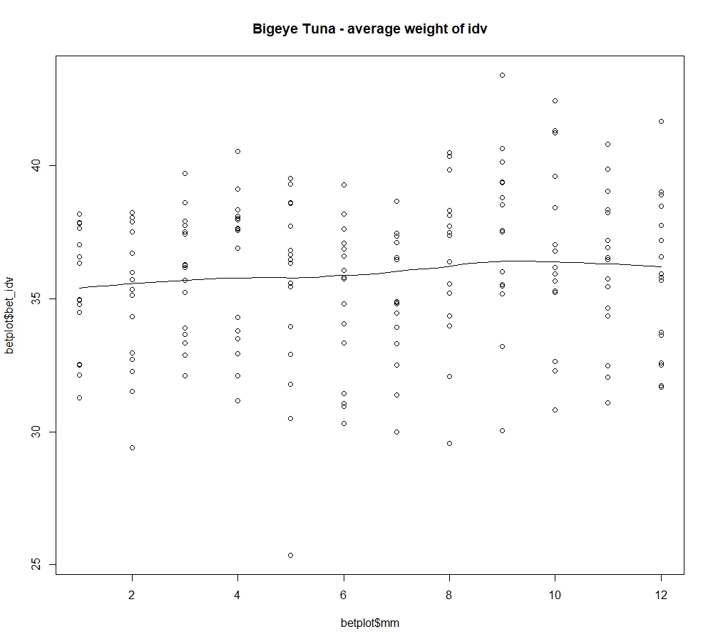
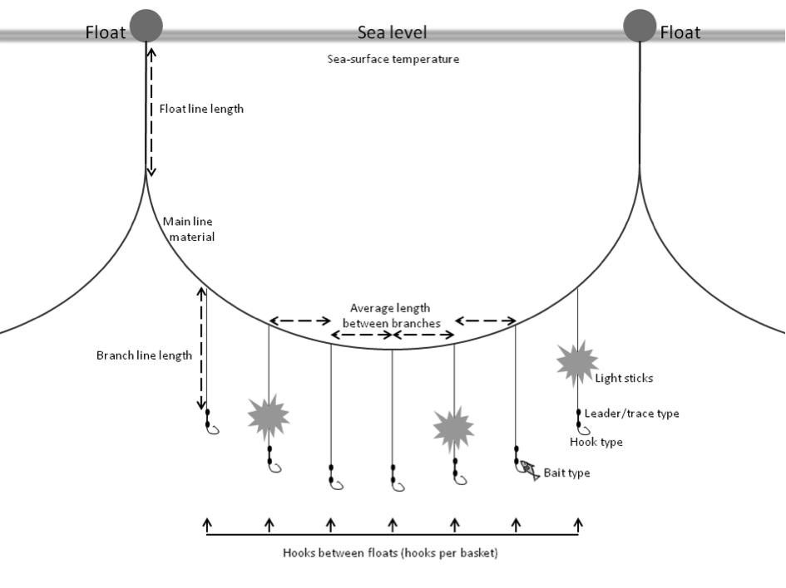

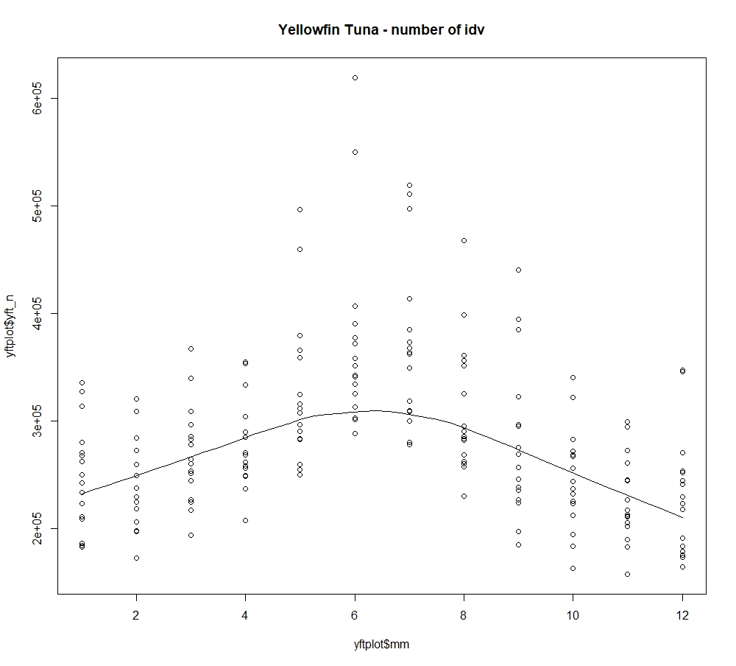
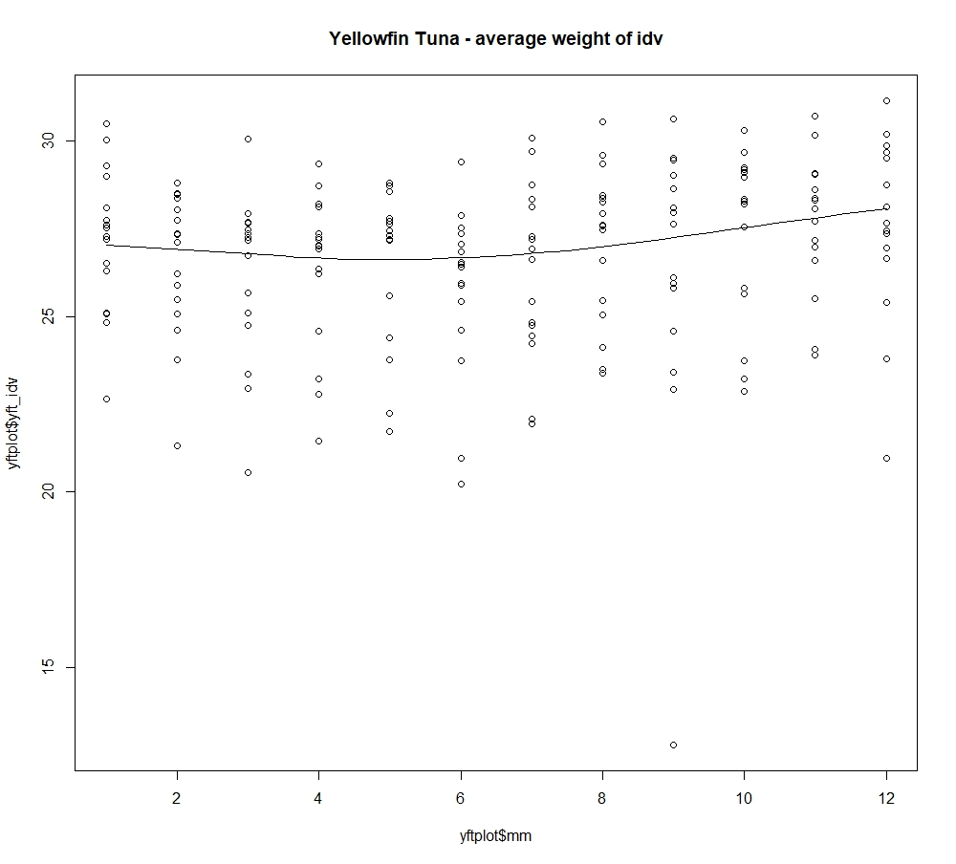
Tuna (Thunnus spp.) Catch by Longliner in WCPFC Convention Area
Edwison S. Firmana (Graduate Student of Dept. of Marine Affairs, University of Rhode Island)
Albacore tuna / ALB (Thunnus alalunga)
Data used are WCPFC data originating from Longliner operating from January 2000 to December 2015 (192 months). The catch data from Longliner consisted of the number of hooks and individual quantities and the total weight (tons) of fish caught from Albacore, Bigeye Tuna, Yellowfin Tuna as main catch, and Stripped Marlin, Black Marlin, Blue Marlin and Swordfish as retained bycatch.
The objective of this data processing is to describe the fluctuations of both number of tuna fished and average of individual weight based on time series throughout the year. The average weight is calculated from total weight divided by number of individual of fish. As the result, we can see the largest number of individual tuna fished season and the largest average weight of tuna fished within the span of one year.
From data processing, we see that the trend of number of fish and average weight of Albacore has the opposite pattern. Albacore was most caught in the middle of the year, around May-July, but with the lowest average weight. While at the end and beginning of the year (Des-Jan), the number of Albacore caught very little but has the largest average individual weight.
A similar pattern occurs in Yellowfin Tuna. Yellowfin Tuna is most caught around May-July, and the least caught is in Des-Jan. However, the average individual weight of Yellowfin Tuna does not fluctuate so significantly. The highest individual weight is in December.
Bigeye Tuna has a different pattern of caught numbers than other two tunas above. The highest number of Bigeye Tuna fished is at the end and the beginning of the year (Dec-Jan) and the least is at the middle of the year (May-June). While the average of individual weight is at the beginning of the year tends to be slightly lower and then increases in mid-year (Aug-Sep).
The combination of the above information can slightly explain that when the average individual weight reaches the lowest point, and at the same time the number of fish caught reaches the highest position, it is possible that the tuna had spawn only a few months earlier. Many small juveniles are caught.
To ensure the age of the captured tuna, it is necessary to retrieve more detailed data on board, such as length and gonads. The taking of gonads on board the Longliner is possible because the fish's gut, including the gonads, will be thrown away by the fishermen, before the fish is stored in storage.
Western and Central Pacific Fisheries Commission is one of regional fisheries body that established to manage fisheries management, especially tuna and other big pelagic fishes in western and central of Pacific Ocean.
Bigeye Tuna / BET (Thunnus obesus)
Yellowfin tuna / YFT (Thunnus alalunga)
Tuna Longline is a type of fishing gear that using hooks strung together in a long mainline. Its target is tunas (Thunnus spp.) and the fishermen retain other value bycatch, for instance bill fishes, such as marlin and swordfish.
Sources:
IOTC (http://www.iotc.org/cmm/resolution-1203-recording-catch-and-effort-fishing-vessels-iotc-area-competence)
NOAA (https://swfsc.noaa.gov/textblock.aspx?Division=FRD&id=21601)
WCPFC (https://www.wcpfc.int/wcpfc-public-domain-aggregated-catcheffort-data-download-page)

Slide 2
